Slide 1
Disastrous Tweet Classification
GROUP MEMBERS
GEERATH
RUSHIKESH
VISHAL
BHOOMI REDDY
DINESH

Slide 2
BUSINESS OBJECTIVE:
One of our clients is a disaster relief organization. So, they actually rely upon twitter as an important medium for their communication. But they often get misled with the kind of tweets whether that actually implies the disaster or not.
GOAL:
So the goal of this project is to identify from the tweet which is a real disaster and which is not.

Slide 3
Project Flow
Business Understanding
Data Understanding
Data Preparation
Data Modelling
Model Evaluation
Model Deployment

Slide 4
Build Dataset using Web Scrapping
A web scraping tool is a software program that’s designed specifically to extract (or ‘scrape’) relevant information from websites.
Find the data you want to extract (library used Beautiful Soup)
For web scraping Site used is - https://twitter.com/DisasterInfoPH?t=Bj7_2WIACImDSEJRQw2j7g&s=08

Slide 5
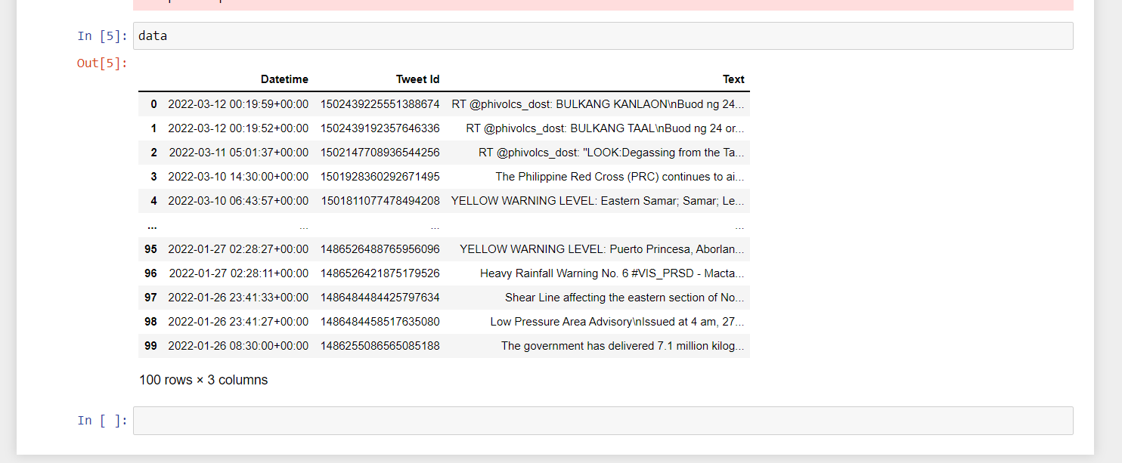
Data Collection
Tweets need to be collected from twitter using the keywords related to disaster manually label them real and fake and use the data to build the classification model to predict real disaster or not.

Slide 6
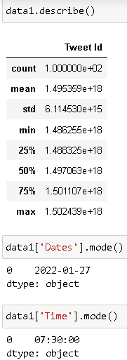
About
The
Data

Slide 7
EDA (Exploratory Data Analysis)
Get maximum useful insights from a data set .
Get a better understanding of data
Understanding data patterns
Drawing charts and graphs for better understanding
Advantages
Increase performance of models
Make training faster
Easy to debug.

Slide 8
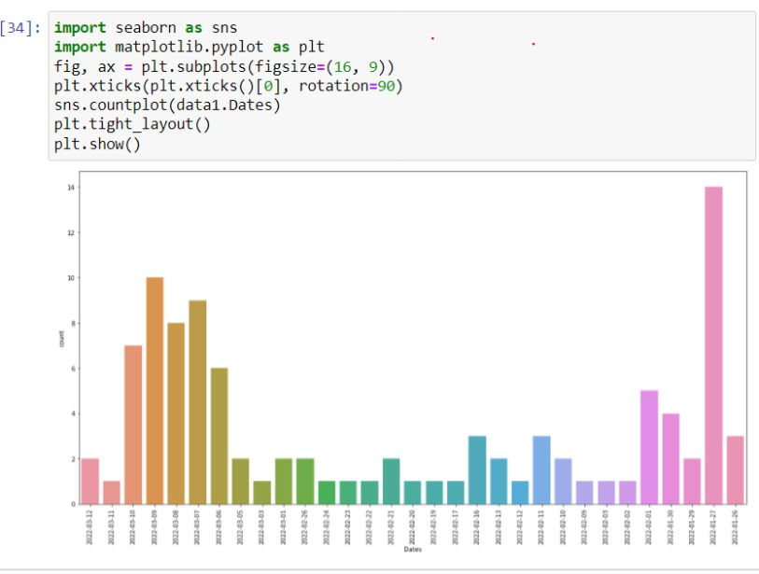
VISUALIZATIONS

Slide 9
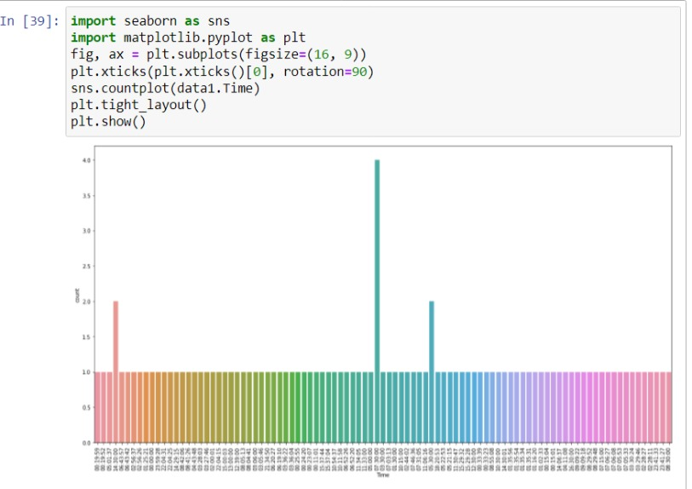

Slide 10
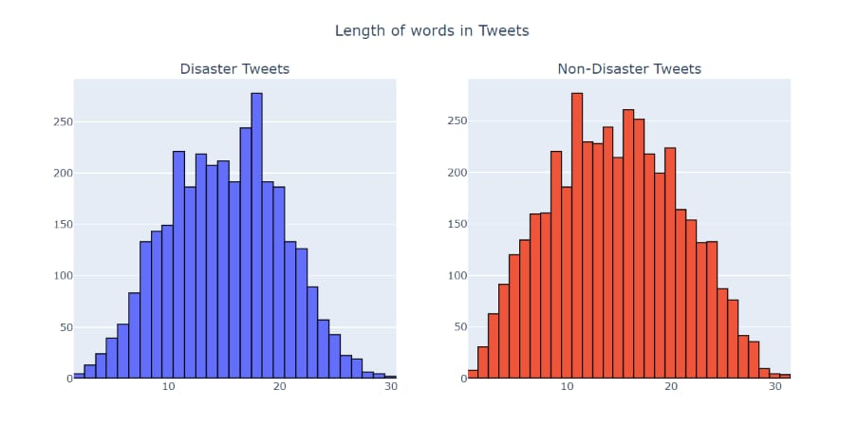

Slide 11
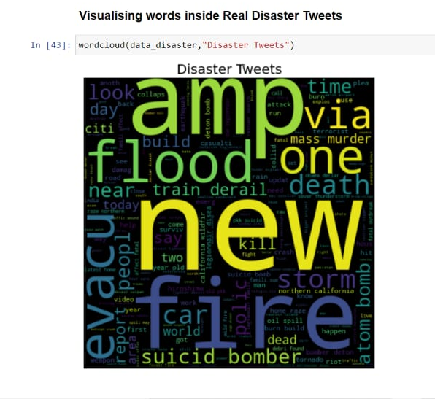
Word
Cloud

Slide 12
Model Building

Slide 13
